Slide 1
Rahul Verma • 09.07.2021
(rahul.v@valuebound.com)

Slide 2
Redux
Overview
A state management system for cross components or better say app-wide state.
Why do we need it?

Slide 3
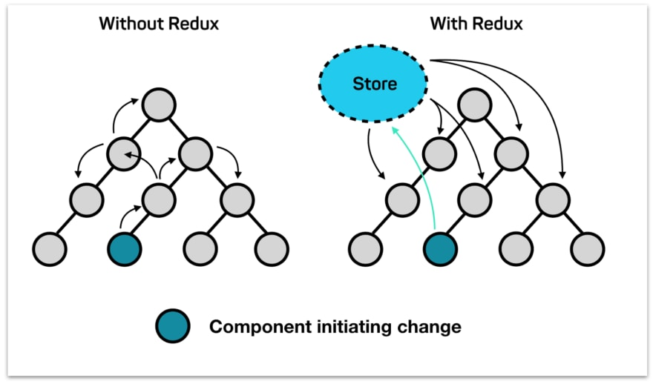

Slide 4
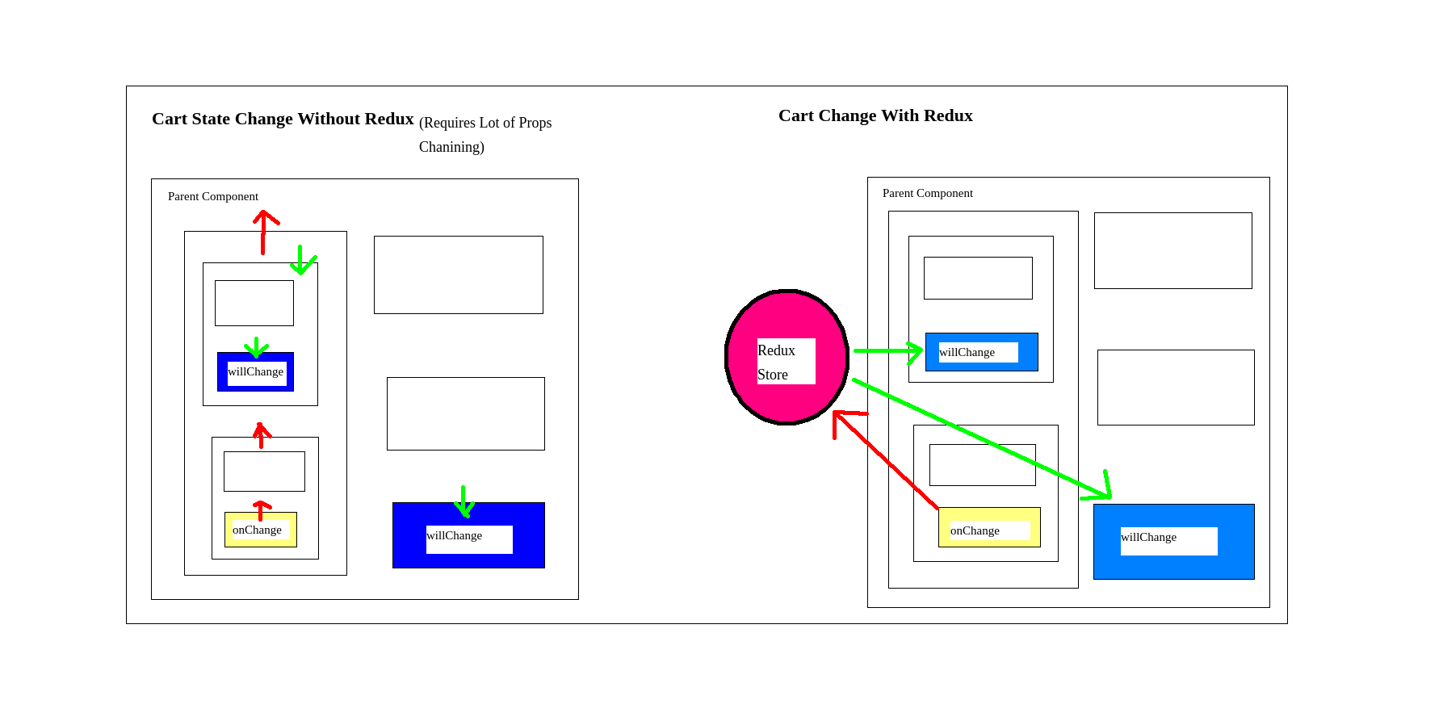

Slide 5
Why use Redux?
Redux makes the state predictable.
Redux is maintainable.
Debugging is easy in Redux.
Performance Benefits.
Ease of testing.
Server-side rendering.

Slide 6
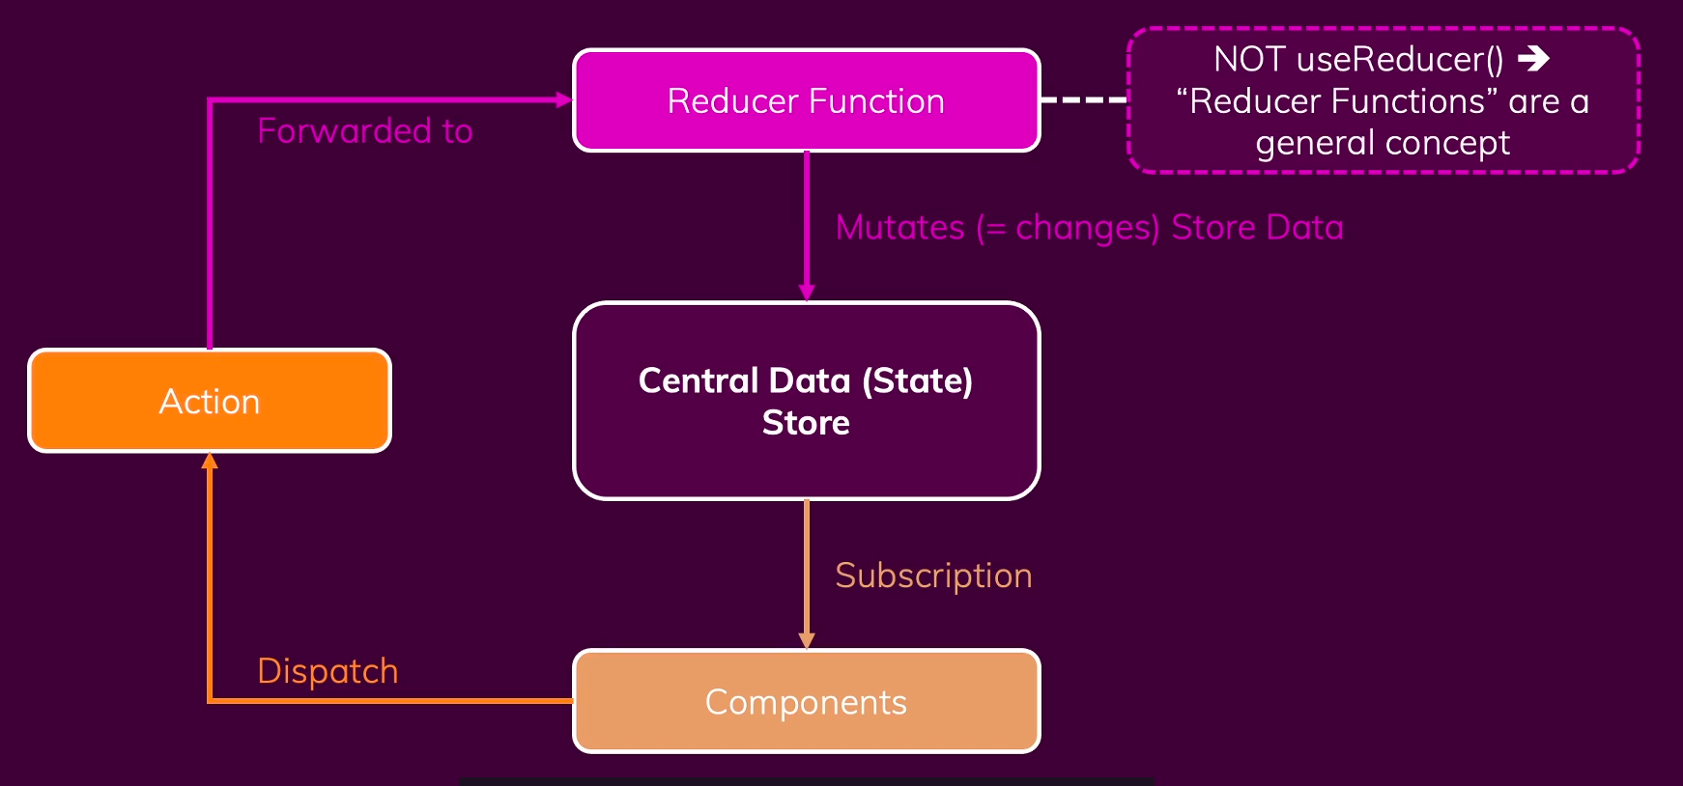
Core Redux Concept
In order to do xyz we can use ******* like this
Share the important syntax of the code / commands

Slide 7
Thunk Middleware
Share the important syntax of the code / commands

Slide 8
Exercise 1
Aim : Create a counter component (shown live by saiteja) using redux store.
Hint: Create a counter redux store, and a counter reducer which takes action type as increment or decrement.

Slide 9
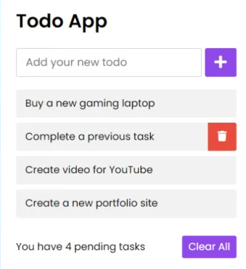
Exercise 2
Aim : Create a todo app using redux store and consume api using axios .
Hint: Create a button, and onClick of it make an api api get request to https://jsonplaceholder.typicode.com/todos,
and add the new todo on frontend only.

Slide 10
Thank you
Questions ?

